Slide 1
Lab Preparation

Slide 2
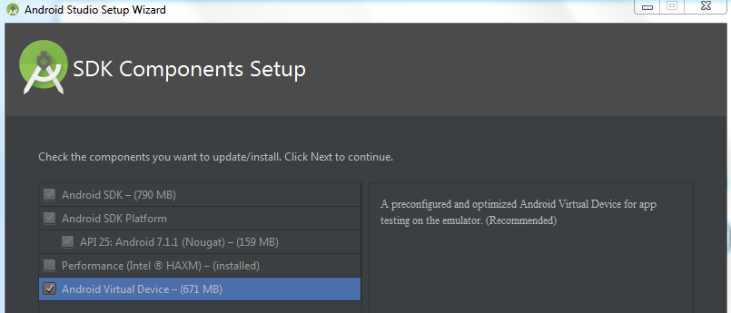
Install Android studio
https://developer.android.com/studio
Download Android studio, launch .exe
Select Android Virtual Device

Slide 3

Create and run project
File > New > New Project
Empty Activity > Language Java
Select Device > Run
(install Haxm if needed)

Slide 4
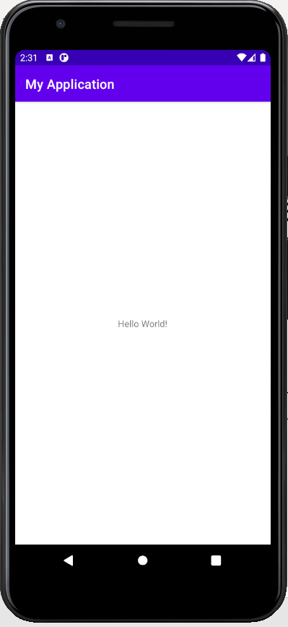
Create and run project

Slide 5
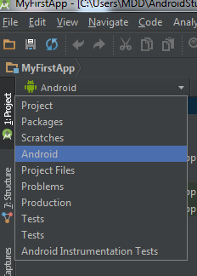
Project Components
View > Tool Windows > Project > Andriod

Slide 6
Project Components
app > java > com.example.myfirstapp > MainActivity.java – This is the main activity. It's the entry point for your app. When you build and run your app, the system launches an instance of this Activity and loads its layout.
app > res > layout > activity_main.xml – This XML file defines the layout for the activity's user interface (UI). Composed of View objects. Can be specified for portrait and landscape mode.
app > manifests > AndroidManifest.xml – The manifest file describes the fundamental characteristics of the app and defines each of its components: Activities/Services/Permissions/Libraries
res
Drawables (like .png images)
Values (like strings: res/values/strings.xml)

Slide 7
Extensible Markup Language (XML)
Preferred way of creating UI
Separates the description of the layout from any actual code that controls it
Can easily take a UI from one platform to another
Both human and machine readable

Slide 8
Lab 1.a Basic UI

Slide 9
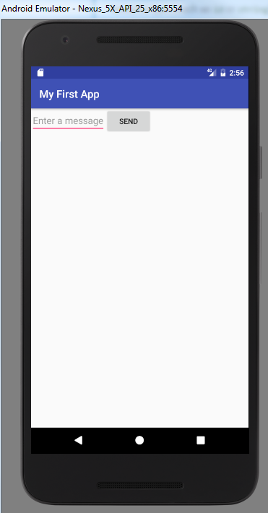
Lab 1.a Basic UI
The app has a interface that contains a button and a text input field.
Once the button is pushed, generate an intent that invokes a second activity
The second activity will display the input string

Slide 10

Step 1: create a UI
app > res > layout > activity_main.xml
Select the code tab
<?xml version="1.0" encoding="utf-8"?>
<LinearLayout xmlns:android="http://schemas.android.com/apk/res/android"
xmlns:tools="http://schemas.android.com/tools"
android:layout_width="match_parent"
android:layout_height="match_parent"
android:orientation="horizontal">
</LinearLayout>
LinearLayout is a view group that aligns all children in a single direction, vertically or horizontally. You can specify the layout direction with the android:orientation attribute.

Slide 11
Step 1: create a UI
Add a Text Field Element
<LinearLayout
xmlns:android="http://schemas.android.com/apk/res/android"
xmlns:tools="http://schemas.android.com/tools"
android:layout_width="match_parent"
android:layout_height="match_parent"
android:orientation="horizontal">
<EditText android:id="@+id/edit_message"
android:layout_width="wrap_content"
android:layout_height="wrap_content"
android:hint="@string/edit_message" />
</LinearLayout>
The EditText is the standard text entry widget in Android apps. If the user needs to enter text into an app, this is the primary way for them to do that.

Slide 12
Step 1: create a UI
res > values > strings.xml
Define the String field
<?xml version="1.0" encoding="utf-8"?>
<resources>
<string name="app_name">My First App</string>
<string name="edit_message">Enter a message</string>
<string name="button_send">Send</string>
</resources>

Slide 13
Step 1: create a UI
res > layout > activity_main.xml
Add a Button
<LinearLayout
xmlns:android="http://schemas.android.com/apk/res/android"
xmlns:tools="http://schemas.android.com/tools"
android:orientation="horizontal"
android:layout_width="match_parent"
android:layout_height="match_parent">
<EditText android:id="@+id/edit_message"
android:layout_width="wrap_content"
android:layout_height="wrap_content"
android:hint="@string/edit_message" />
<Button
android:layout_width="wrap_content"
android:layout_height="wrap_content"
android:text="@string/button_send" />
</LinearLayout>
Button: a user interface element the user can tap or click to perform an action.

Slide 14
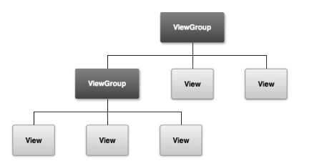
Understand Basic UI Elements
The UI for an Android app is built as a hierarchy of layouts and widgets.
Layouts are ViewGroup objects, containers that control how their child views are positioned on the screen. e.g. LinearLayout
Widgets are View objects, UI components e.g. Text field, Button

Slide 15
Run the app

Slide 16
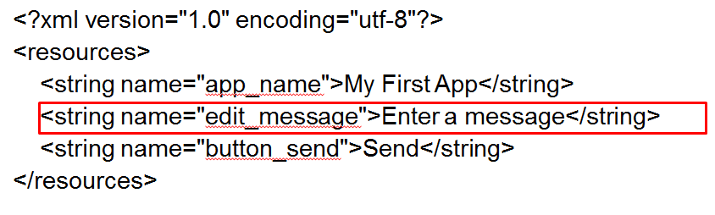

Play around UI
Change the string field
Change width of text field

Slide 17
Step 2: control the UI
res > layout > activity_main.xml
Add a field to the Button View
<Button
android:layout_width="wrap_content"
android:layout_height="wrap_content"
android:text="@string/button_send"
android:onClick="sendMessage" />
Now when the button is tapped, the system calls the sendMessage() method.

Slide 18
Step 2: control the UI
java > com.example.myfirstapp >MainActivity.java
Create a Intent (an object that deliver message in run time between separate components, such as two activities)
public final static String EXTRA_MESSAGE = "com.example.myfirstapp.MESSAGE";
public void sendMessage(View view) {
Intent intent = new Intent(this, DisplayMessageActivity.class);
EditText editText = (EditText) findViewById(R.id.edit_message);
String message = editText.getText().toString();
intent.putExtra(EXTRA_MESSAGE, message);
startActivity(intent);
}

Slide 19
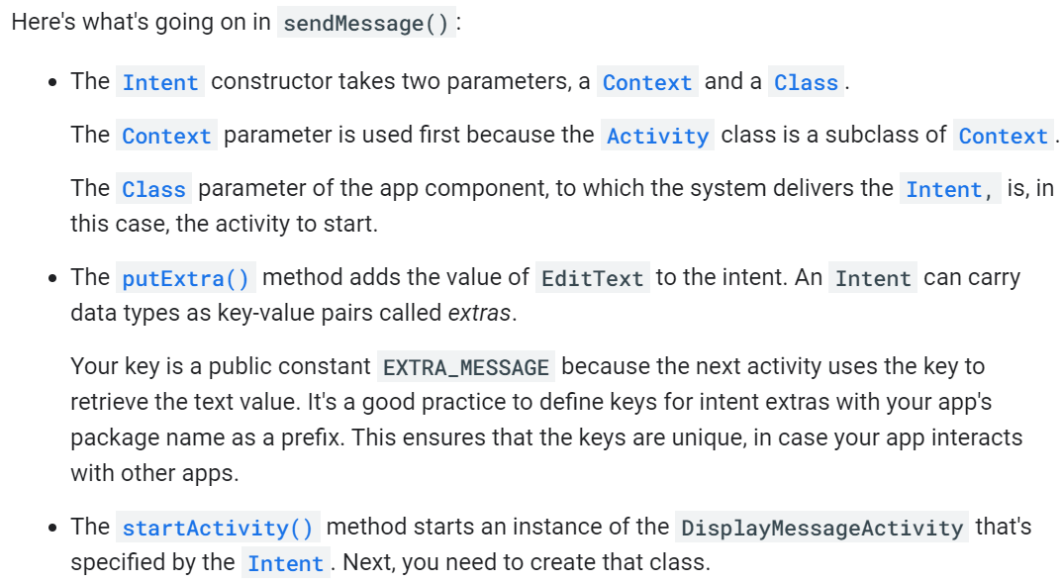
Some notes

Slide 20
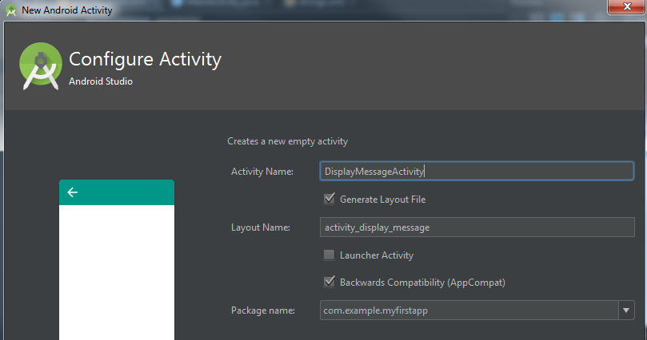
Step 2: control the UI
Create a new Activity
Java > com.example.myapplication
New > activity > empty activity
Activity name: DisplayMessageActivity

Slide 21
Step 2: control the UI
DisplayMessageActivity.java
public class DisplayMessageActivity extends AppCompatActivity {
@Override
protected void onCreate(Bundle savedInstanceState) {
super.onCreate(savedInstanceState);
setContentView(R.layout.activity_display_message);
Intent intent = getIntent();
String message = intent.getStringExtra(MainActivity.EXTRA_MESSAGE);
TextView textView = new TextView(this);
textView.setTextSize(40);
textView.setText(message);
ViewGroup layout = (ViewGroup) findViewById(R.id.activity_display_message);
layout.addView(textView);
}
}
activity_display_message.xml
android:id="@+id/activity_display_message"
Note: The XML layout generated by previous versions of Android Studio might not include the android:id attribute. The call findViewById() will fail if the layout does not have the android:id attribute. If this is the case, open activity_display_message.xml and add the attribute android:id="@+id/activity_display_message" to the layout element.

Slide 22
Step 2: control the UI
In MainActivity.java and DisplayMessageActivity.java
Use Alt + Enter to import class

Slide 23
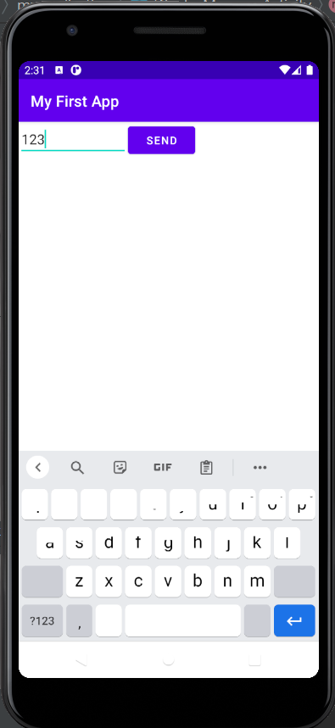
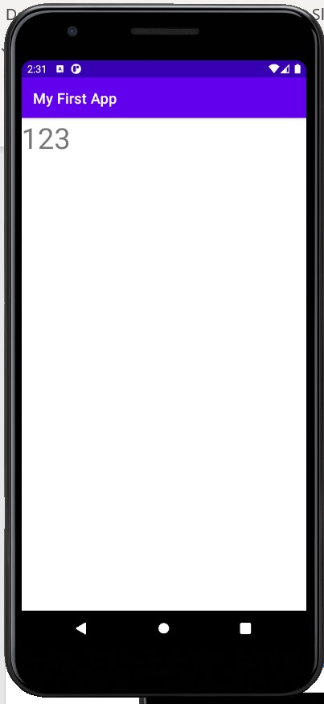
Run the App

Slide 24
Lab 1.b FragmentBasics

Slide 25
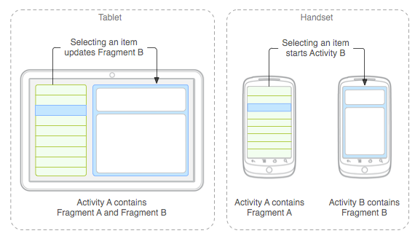
Fragments
A Fragment represents a portion of user interface in an Activity.
can combine multiple fragments in a single activity, or reuse a fragment in multiple activities.

Slide 26
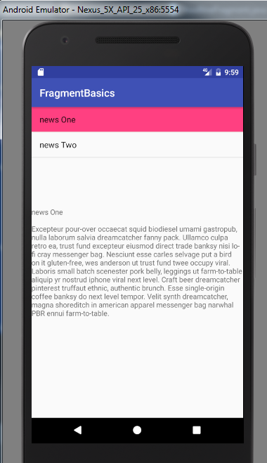
Lab 1.b FragmentBasics
Create two fragments. One is a list fragment that contains all news headlines, the other is a fragment that displays the news article
Display the two fragments inside a single activity

Slide 27
File > New > New Project
Empty Activity > Language Java
Name: FragmentBasics

Slide 28
Java > com.example.fragmentbasics > New > Java Class
Create Ipsum.java class (That is a capital i)
package com.example.fragmentbasics;
public class Ipsum {
static String[] Headlines = {
"Article One",
"Article Two"
};
static String[] Articles = {
"Article One\n\nExcepteur pour-over occaecat squid biodiesel umami gastropub, nulla laborum salvia dreamcatcher fanny pack. Ullamco culpa retro ea, trust fund excepteur eiusmod direct trade banksy nisi lo-fi cray messenger bag. Nesciunt esse carles selvage put a bird on it gluten-free, wes anderson ut trust fund twee occupy viral. Laboris small batch scenester pork belly, leggings ut farm-to-table aliquip yr nostrud iphone viral next level. Craft beer dreamcatcher pinterest truffaut ethnic, authentic brunch. Esse single-origin coffee banksy do next level tempor. Velit synth dreamcatcher, magna shoreditch in american apparel messenger bag narwhal PBR ennui farm-to-table.",
"Article Two\n\nVinyl williamsburg non velit, master cleanse four loko banh mi. Enim kogi keytar trust fund pop-up portland gentrify. Non ea typewriter dolore deserunt Austin. Ad magna ethical kogi mixtape next level. Aliqua pork belly thundercats, ut pop-up tattooed dreamcatcher kogi accusamus photo booth irony portland. Semiotics brunch ut locavore irure, enim etsy laborum stumptown carles gentrify post-ironic cray. Butcher 3 wolf moon blog synth, vegan carles odd future."
};
}

Slide 29
Create a new fragment
Java > com.example.fragmentbasics > New > Fragment > Fragment (Blank)
Fragment name: NewsFragment

Slide 30
public class NewsFragment extends Fragment{
final static String ARG_POSITION = "position";
int mCurrentPosition = -1;
@Override
public View onCreateView(LayoutInflater inflater, ViewGroup container,
Bundle savedInstanceState) {
// Inflate the layout for this fragment
return inflater.inflate(R.layout.fragment_news, container, false);
}
@Override
public void onStart() {
super.onStart();
//During startup, check if there are arguments passed to the fragment.
// onStart is a good place to do this because the layout has already been
// applied to the fragment at this point so we can safely call the method
// below that sets the article text.
Bundle args = getArguments();
if (args != null) {
// Set article based on argument passed in
updateArticleView(args.getInt(ARG_POSITION));
} else if (mCurrentPosition != -1) {
// Set article based on saved instance state defined during onCreateView
updateArticleView(mCurrentPosition);
}
}
public void updateArticleView(int position) {
TextView article = (TextView) getActivity().findViewById(R.id.news);
article.setText(Ipsum.Articles[position]);
mCurrentPosition = position;
}
@Override
public void onSaveInstanceState(Bundle outState) {
super.onSaveInstanceState(outState);
// Save the current article selection in case we need to recreate the fragment
outState.putInt(ARG_POSITION, mCurrentPosition);
}
}

Slide 31
Create a new fragment
Java > com.example.fragmentbasics > New > Fragment > Fragment (List)
Fragment name: HeadlineFragment

Slide 32
Java > com.example.fragmentbasics > HeadlineFragment.java
public class HeadlineFragment extends ListFragment {
OnHeadlineSelectedListener mCallback;
// Container Activity must implement this interface
public interface OnHeadlineSelectedListener {
public void onArticleSelected(int position);
}
@Override
public void onAttach(Activity activity) {
super.onAttach(activity);
// This makes sure that the container activity has implemented
// the callback interface. If not, it throws an exception
try {
mCallback = (OnHeadlineSelectedListener) activity;
} catch (ClassCastException e) {
throw new ClassCastException(activity.toString()
+ " must implement OnHeadlineSelectedListener");
}
}
@Override
public void onListItemClick(ListView l, View v, int position, long id) {
// Notify the parent activity of selected item
mCallback.onArticleSelected(position);
// Set the item as checked to be highlighted when in two-pane layout
getListView().setItemChecked(position, true);
}
}

Slide 33
@Override
public void onCreate(Bundle savedInstanceState) {
super.onCreate(savedInstanceState);
int layout = android.R.layout.simple_list_item_activated_1;
setListAdapter(new ArrayAdapter<String>(getActivity(), layout, Ipsum.Headlines));
}
@Override
public void onStart() {
super.onStart();
if (getFragmentManager().findFragmentById(R.id.news_fragment) != null) {
getListView().setChoiceMode(ListView.CHOICE_MODE_SINGLE);
}
}

Slide 34
Java > com.example.fragmentbasics > MainActivity.java
implement the interface for the list fragment
public class MainActivity extends AppCompatActivity implements HeadlineFragment.OnHeadlineSelectedListener{
@Override
protected void onCreate(Bundle savedInstanceState) {
super.onCreate(savedInstanceState);
setContentView(R.layout.activity_main);
}
public void onArticleSelected(int position) {
NewsFragment newsFragment = (NewsFragment) getSupportFragmentManager().findFragmentById(R.id.news_fragment);
newsFragment.updateArticleView(position);
}
}

Slide 35
res > layout > activity_main.xml
Organize these two fragments
<?xml version="1.0" encoding="utf-8"?>
<LinearLayout xmlns:android="http://schemas.android.com/apk/res/android"
android:orientation="vertical"
android:id="@+id/fragment_container"
android:layout_width="match_parent"
android:layout_height="match_parent">
<fragment android:name="com.example.fragmentbasics.HeadlineFragment"
android:id="@+id/headlines_fragment"
android:layout_weight="1"
android:layout_width="match_parent"
android:layout_height="wrap_content" />
<fragment android:name="com.example.fragmentbasics.NewsFragment"
android:id="@+id/news_fragment"
android:layout_weight="2"
android:layout_width="match_parent"
android:layout_height="wrap_content" />
</LinearLayout>

Slide 36
In HeadlineFragment.java and NewsFragment.java, use Alt + Enter to import class
res > layout > fragment_news.xml
<TextView
android:id="@+id/news"
android:layout_width="match_parent"
android:layout_height="match_parent“
android:text="@string/hello_blank_fragment" />

Slide 37
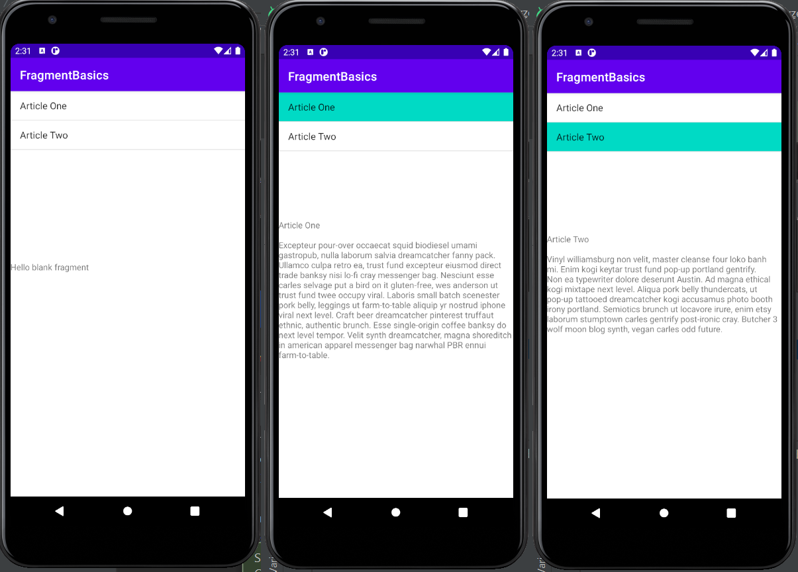
Run the app

Slide 38
Other activities
Play around different layouts
Table Layout
RelativeLayout
FrameLayout
Run the app in the phone

Slide 39
Assignment
Finish both lab 1.a and 1.b.
Show TA the results on Jan 26/Jan 28,
or at the latest Feb 2/Feb 4
Extra credits: change of phone orientations. Build an app with two fragments (a headline fragment and a news fragment). The app should display only a single fragment when the phone is held in portray position, and display both fragments at the same time when the phone is held in landscape position.

Slide 40
References
Developer’s Guide
http://developer.android.com/guide/index.html
API Reference
http://developer.android.com/reference/packages.html
A good webpage
http://users.jyu.fi/~mijoahon/android/

Slide 41
References
Install Android Studio (https://developer.android.com/studio/install.html)
Install Android Virtual Device
https://developer.android.com/studio/run/managing-avds.html
Install drivers for Android phone
(Windows:https://developer.android.com/studio/run/oem-usb.html
*nix:https://developer.android.com/studio/run/device.html)
Enable Android Development
https://www.kingoapp.com/root-tutorials/how-to-enable-usb-debugging-mode-on-android.htm

Slide 42
References
First app:
https://developer.android.com/training/basics/firstapp/creating-project.html
Lab 1.a
https://developer.android.com/training/basics/firstapp/creating-project.html
Lab 1.b
https://developer.android.com/training/basics/fragments/index.html

